Slide 1
Ministry of Higher Education Kabul university faculty of Information & communication technology
C++ Programming

Slide 2
Loop
a loop is a control structure that allows you to repeat a block of code multiple times, which is useful when you want to execute the same set of instructions repeatedly under certain conditions. Loops help reduce the need for repetitive code and make programs more efficient. C++ provides three main types of loops:
For Loop
While Loop
Do-While Loop

Slide 3
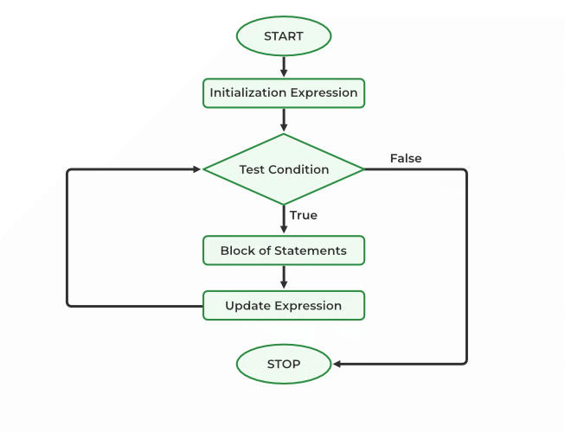
For Loop
The for loop is typically used when the number of iterations is known beforehand. It consists of three main parts:
Initialization: Setting up the loop variable.
Condition: The condition that determines if the loop should continue running.
Increment/Decrement: Updates the loop variable after each iteration

Slide 4
For loop Cont.…
Initialization: This part initializes the loop variable. It typically declares and assigns an initial value to the loop variable. For example, int i = 0;.
Condition: This part specifies the condition that is checked before each iteration of the loop. If the condition evaluates to true, the loop body is executed; otherwise, the loop terminates. For example, i < 5.
Update: This part is responsible for updating the loop variable after each iteration of the loop body. It can be an increment (i++), decrement (i--), or any other operation that modifies the loop variable. For example, i++.

Slide 5
For loop Cont...
Syntax:
for (initialization; condition; increment/decrement) { // Code to execute repeatedly }
Example:
#include <iostream>
using namespace std;
int main() { // This for loop will print numbers from 1 to 5
for (int i = 1; i <= 5; i++) {
cout << i << " ";
}
return 0;
}

Slide 6
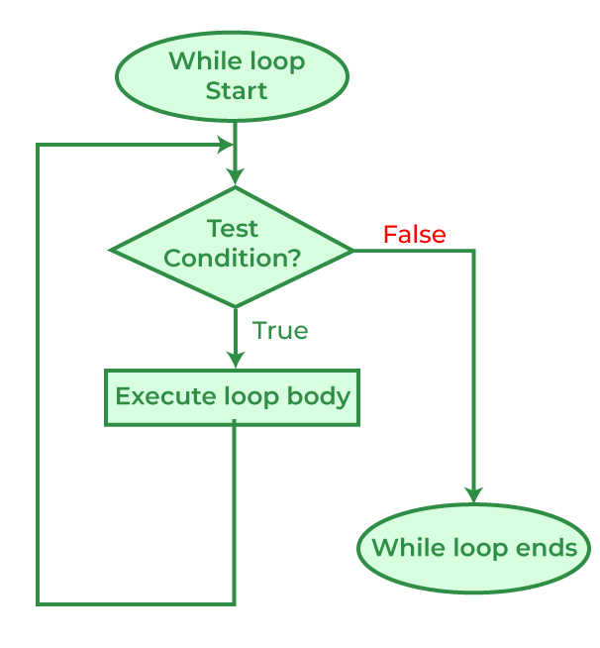
While Loop
The while loop is used when the number of iterations is not known, and you want the loop to run as long as a certain condition is true. It checks the condition before entering the loop.
Syntax:
while (condition) {
// Code to execute repeatedly
}

Slide 7
While Loop Example
int count ;
count = 0; // initialize
while (count < 5) // test expression
{
cout << count << “ ”; // repeated action
count = count + 1; // update
}
cout << “Done” << endl ;

Slide 8
Loop Tracing
int count ;
count = 0;
while (count < 5)
{
cout << count << “ ”;
count = count + 1;
}
cout << “Done” << endl ;
count Expression Output
0 true 0
1 true 0 1
2 true 0 1 2
3 true 0 1 2 3
4 true 0 1 2 3 4
5 false 0 1 2 3 4 Done

Slide 9
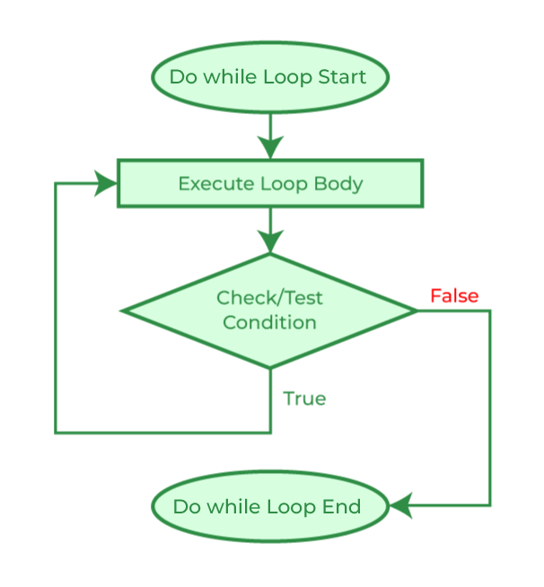
Do-While Loop
The do-while loop is similar to the while loop,
But it checks the condition after the loop has executed.
This guarantees that the loop will always run at least once
Syntax:
do {
// Code to execute repeatedly
}
while (condition);

Slide 10
Do While Example
#include <iostream>
using namespace std;
int main() {
int i = 1; // This do-while loop will print numbers from 1 to 5 do {
cout << i << " "; i++; // Increment the value of I
}
while (i <= 5); return 0;
}

Slide 11
Example
#include <iostream>
Using namespace std;
int main()
{ for (int i = 0; i < 5; i++)
{
cout << "Iteration " << i << endl;
}
return 0;
}

Slide 12
Nested loops
Nested loops in C++ refer to the concept of having one loop inside another loop. This allows for more complex and structured iterations over data structures like arrays, matrices, or any other multi-dimensional data.
Outer Loop: The outer loop serves as the primary loop controlling the overall iteration. It contains another loop inside it.
Inner Loop: The inner loop is nested within the outer loop. It's executed multiple times for each iteration of the outer loop.
Iteration: For each iteration of the outer loop, the inner loop is executed from start to finish. This process continues until the outer loop's condition is no longer met.

Slide 13
Syntax of Nested loops
for (initialization; condition; update)
{
// Outer loop code
for (inner_initialization; inner_condition; inner_update) {
// Inner loop code
}
}

Slide 14
Strings in C++
Strings are sequences of characters used to represent text in C++.
Understanding how to manipulate strings is essential for many programming tasks.

Slide 15
Declaring and Initializing Strings
Strings can be declared using the string class from the #include <string> header.
Example: string str = "Hello, World!";
Strings can also be initialized using constructors or assignment.

Slide 16
String Operations
Various operations are available to manipulate strings in C++.
Concatenation, comparison, substring extraction, finding length, and accessing characters are some common operations.

Slide 17
String Concatenation
Strings can be concatenated using the + operator or the append() method.
Example:
string str1 = "Hello";
string str2 = "World";
string result = str1 + " " + str2;

Slide 18
String Comparison
Strings can be compared using relational operators (<, <=, ==, !=, >, >=) or the compare() method.
Example:
string str1 = "apple";
string str2 = "banana";
int result = str1.compare(str2);

Slide 19
Finding Length of String
Length of a string can be found using the length() method or the size() method.
Example
string str = "Hello";
int length = str.length();

Slide 20
Modifying Strings
Strings in C++ are mutable and can be modified.
Characters in a string can be changed directly.
Example
string str = "Hello";
str[1] = 'a'; // Changes second character to 'a'

Slide 21
Thanks

